Slide 1

Introduction to ICT

Slide 2
Input Statements
Input()
Input function is used to accept in put from the keyboard.
This function stop the program flow until input is provided.
Regardless of the input given by user, this function convert it into string.
Type conversion is used to convert it into desired datatype.
Syntax:
input([prompt])
Prompt can be a string , a message, representing a default message before input, its optional.

Slide 3
Type Conversion
Converting one data type into another data type is called Type Conversion.
Types:
Implicit
Explicit
Implicit Type Conversion:
Python automatically converts one data type into another data type.
Explicit Type Conversion:
Programmer converts one data type into another data type.(Type Casting)

Slide 4
If Statement
If statement is used to execute an instruction or block of instructions only if the condition is satisfied or fulfilled.
Syntax:
if(condition):
statement
Rest of the code
if there is a single statement in if, it can be written in a single line
if(condition):statement

Slide 5
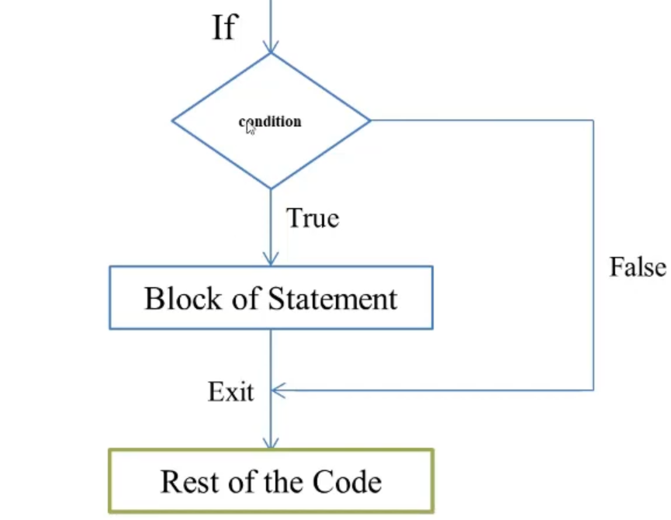
If Statement flow chart

Slide 6
If else Statement
It is used when a different sequence of instructions are to be executed depending on the logical value (T/F) of the condition evaluated.
Syntax:
if(condtion):
statement
else:
statement
Rest of the code

Slide 7
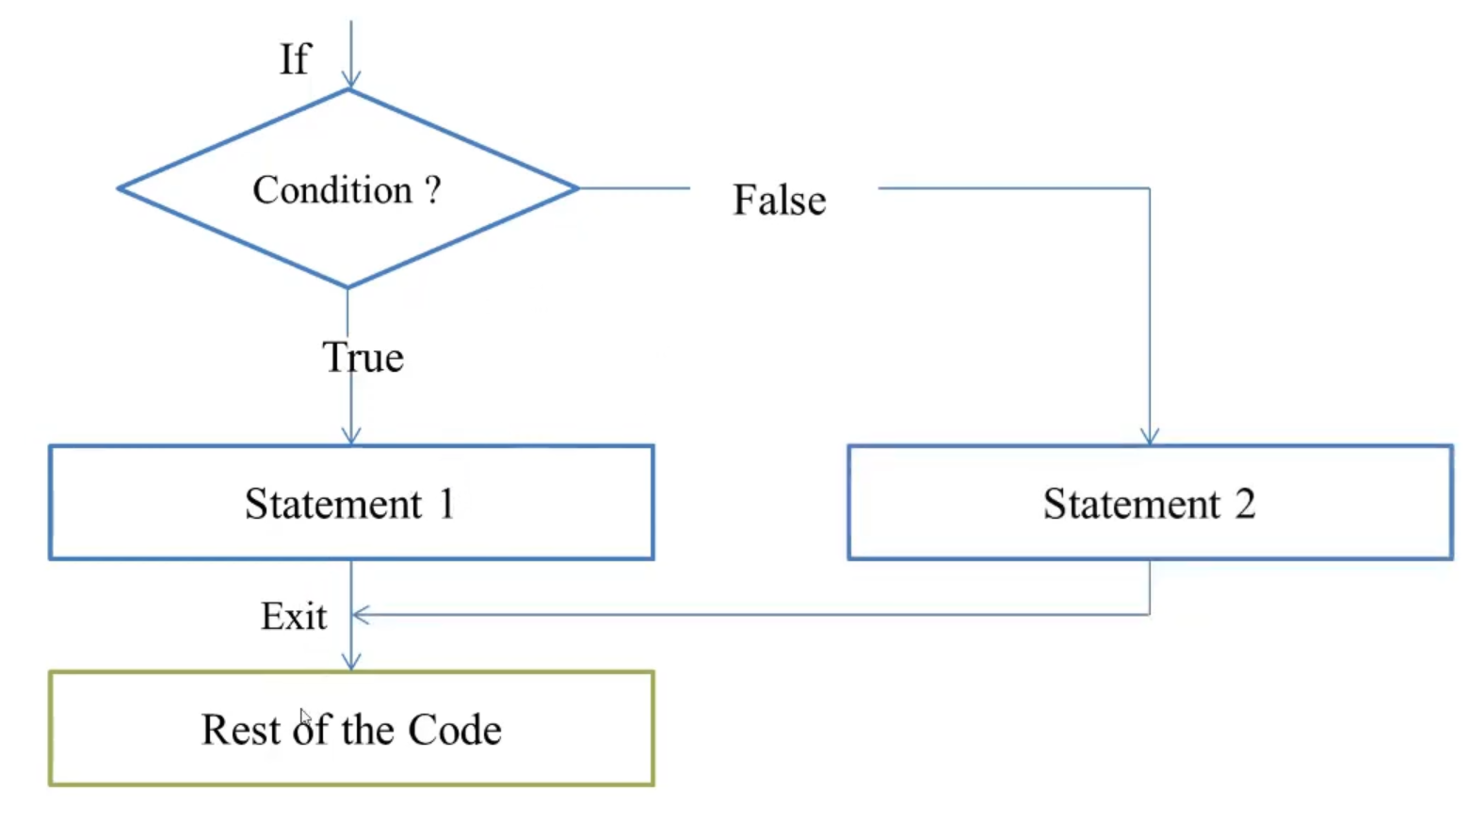
If else Statement flow chart

Slide 8
If elif Statement
To show a multi-way decision based on several condition, if elif statement is used
Syntax:
if(condtion_1):
statement
elif(condtion_2):
statement
elif(condtion_3):
statement
Rest of the Code

Slide 9
If elif else Statement
To show a multi-way decision based on several condition, if elif else statement is used
Syntax:
if(condtion_1):
statement
elif(condtion_2):
statement
elif(condtion_3):
statement
else:
statement
Rest of the Code

Slide 10
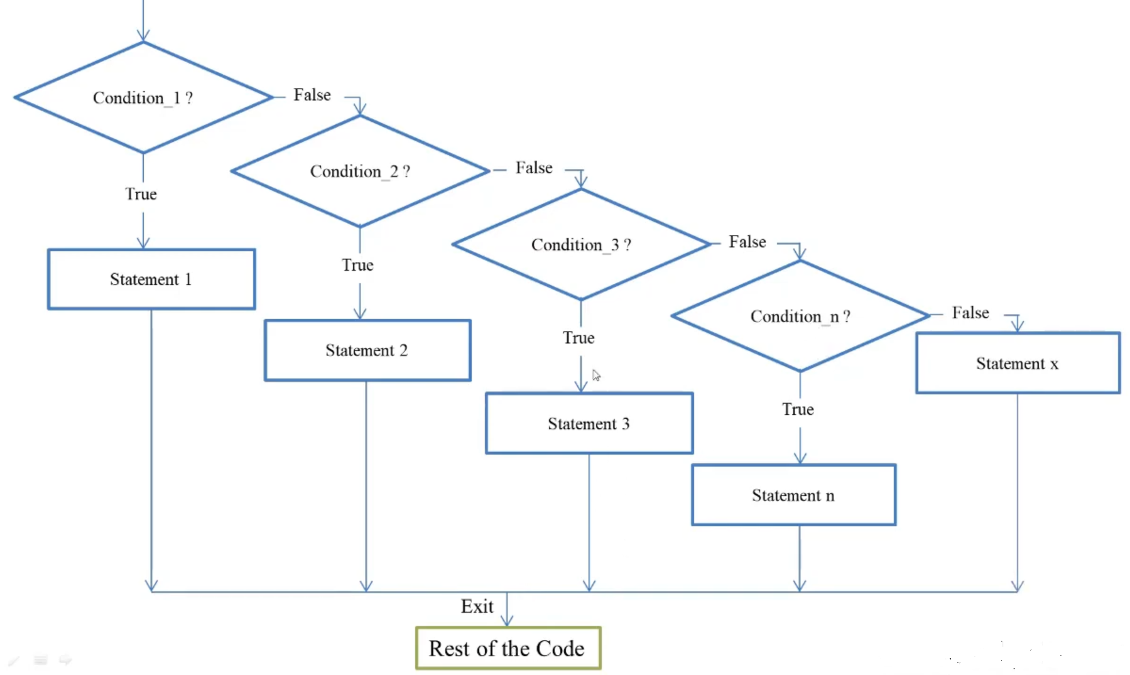
If elif Statement flow chart

Slide 11
Nested If Statement
If statement written inside(within the body) another if statement.
Syntax:
if(condtion):
statement
if(condtion):
statement
if(condtion):
statement
if(condtion)
statement
Rest of the Code

Slide 12
LIST

Slide 13
List
A list represent group of elements.
Lists are mutable i.e. we can modify its elements.
A list can store different types of elements which can be modified.
Lists are dynamic which means sizes is not fixed.
Lists are represented using square backets.

Slide 14
Creating List
Syntax:
list_name =[element1, element2, ….]
We can also create an Empty list as:
Syntax:
list_name = []

Slide 15
Index
An index represents the position number of a list’s element.
The index start from 0 on wards.
Index is written inside square braces.

Slide 16
Accessing a List
A list can be accessed using Indexes.

Slide 17
Modifying or Updating elements in a List
List is mutable.

Slide 18
Slicing on a List
Slicing on list can be used to retrieve a piece of a list that contains a group of elements.
Useful to retrieve a range of elements.
Syntax:
new_list_name= list_name[start:stop:stepsize]

